Slide 1
SDN Software define networking

Slide 2
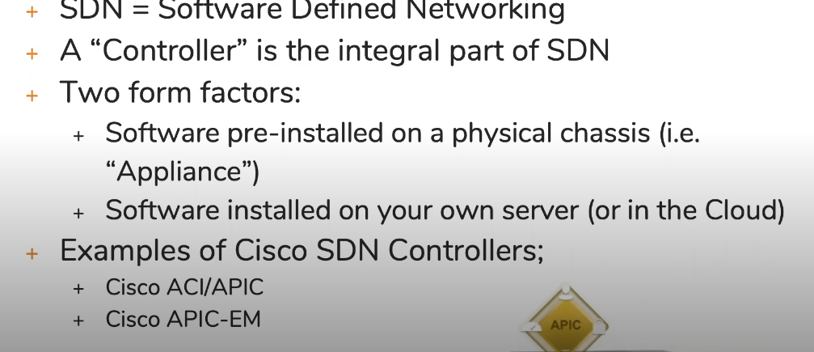
SDN controllers
SDN – Software define networking
Before SDN you need to login to each and every device and to the configuration.
Need to do configuration hop by hop basis
With SDN we are having the central device and from that we can program them

Slide 3
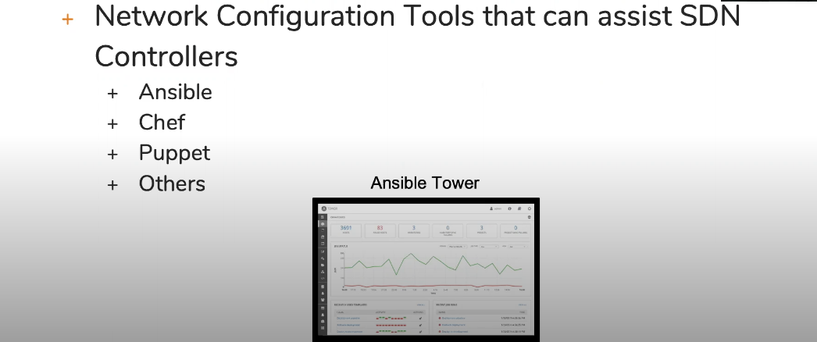
Network automation software tools
These controllers might have built in software tools or might reach out to other network automation software tools.
These tools can be installed on the Linux or Windows platform and they will reach out to the router and switches to program them.
Lot of times your SDN controller will be paired to one of the automation tools or some SDN controller have inbuild software to reach out to the routers and switches to configure them.

Slide 4
Scripting for network automation
So the first thing what to want to do with the network automation tool is lets say once I install it I want to apply some config file to the router or switches.
So first thing you will check what are the common things that all devices needs to be configured same. Lets say the same common set of vlans so you can push to all the devices.
Now how will you create that configuration file. These software automation tools needs some kind of scripting language in order to create the configuration. You can use some sort of scripting language to automate the process of configuring the device.
These tools will implement the script remotely and send to over ip connection.
Some of the IOS-XE device allows you to build the script on box and implement it

Slide 5
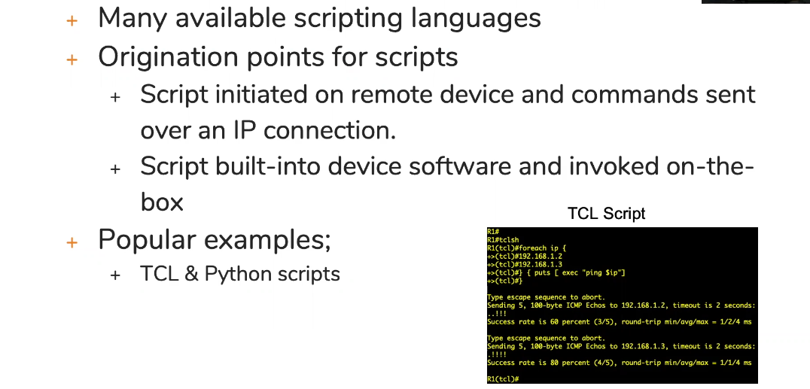
Scripting for network automation

Slide 6
Approaches for SDN controllers
There are different approaches for how your controller is going to control your network.
There are 2 approaches for the conteroller:
Imperative approach
Declarative approach

Slide 7
Imperative approach to the controller
In this approach the control plane logic will reside in the controller
All the control plane decision will be done by the controller.
Previously all the devices run their own control plane
The initial approach of SDN was the imperative approach
Lets take the example of the routing protocol:
Lets not tell router what routing protocol is and router will report to the controller all the information regarding themselves like what links they have, what are the network.
Now the controller is running the routing protocol and it knows about all the devices in network and what are he networks running on each devices.
So controller will pick up the best route and sent it to the routers. Now controller is responsible for populating the routing table.

Slide 8
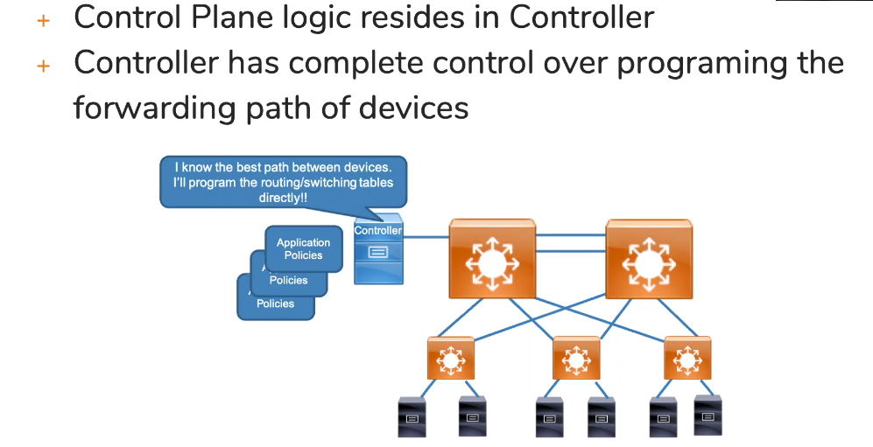
Imperative approach to the controller

Slide 9
Declarative approach for controllers
Now for cisco all the device are already functioned to build the control plane and it doesn’t really work for them to run the imperative approach.
So cisco decided their controller to use the declarative approach. Which means the control plane still resides at the networking devices.
Controller declares the requirement of applications. This means the applications running on the end servers will be speaking to the controllers and tell the requirement that what is the destination and how much delay and latency should be there in the network.
Now once controller receive that requirement, it reaches to each and every device and know how the routing table looks like and what are the interface statistics. So what controller will do based on the requirement it will dynamically configures some access list or QOS or firewall policy on the devices to fulfil the requirement of the application
Or it could be the other way, the controller will just declare the requirement and the network devices based on the requirement make the changes on their own.

Slide 10
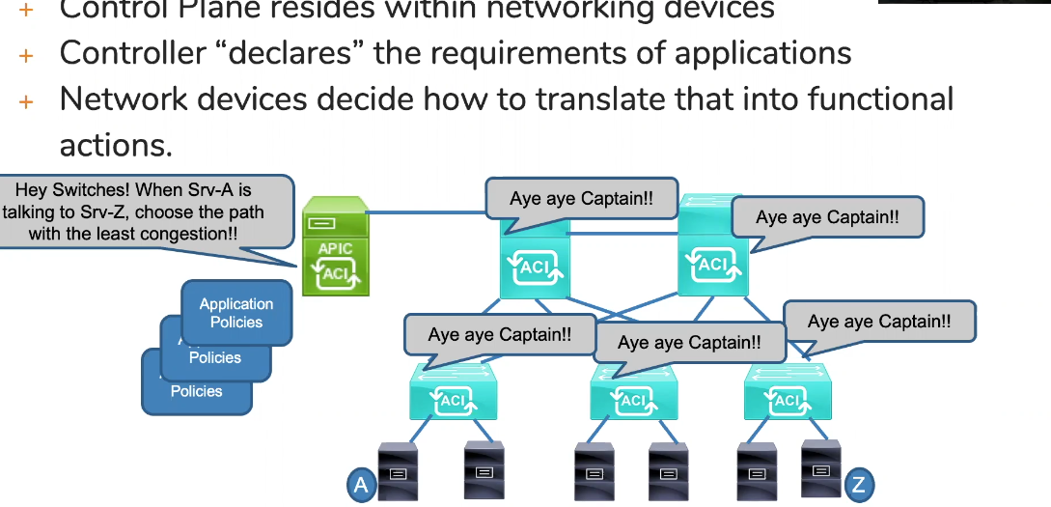
Declarative approach for controllers

Slide 12
Controller based network architectures
Architectural concepts:
Underlay network
Overlay network
SDN fabric

Slide 13
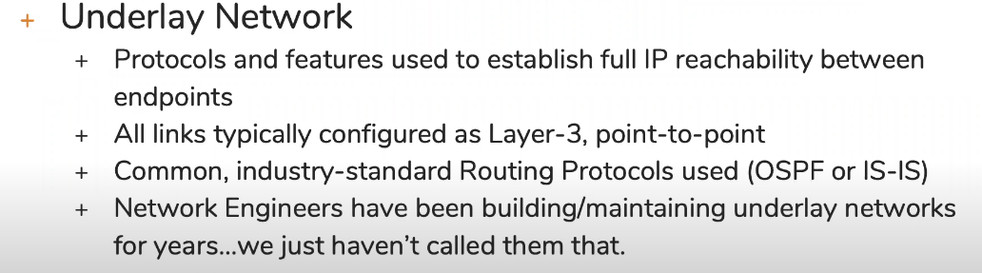
Underlay and overlay
When you implement the SDN controller in your network the idea is still the same that devices needs to learn route and make routing decision how to send traffic from point A to point B

Slide 14
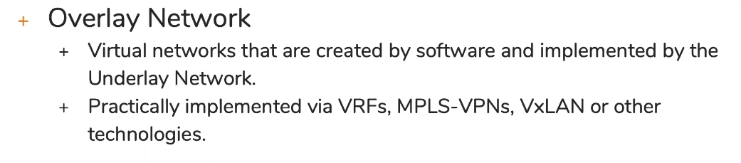
Underlay and overlay
Now once the network is built and all the device reachability is there.
The application will tell the requirement to the controller and controller will declare the requirement to the network devices then then they will dynamically change the topology. This is taking place over the existing networks

Slide 15
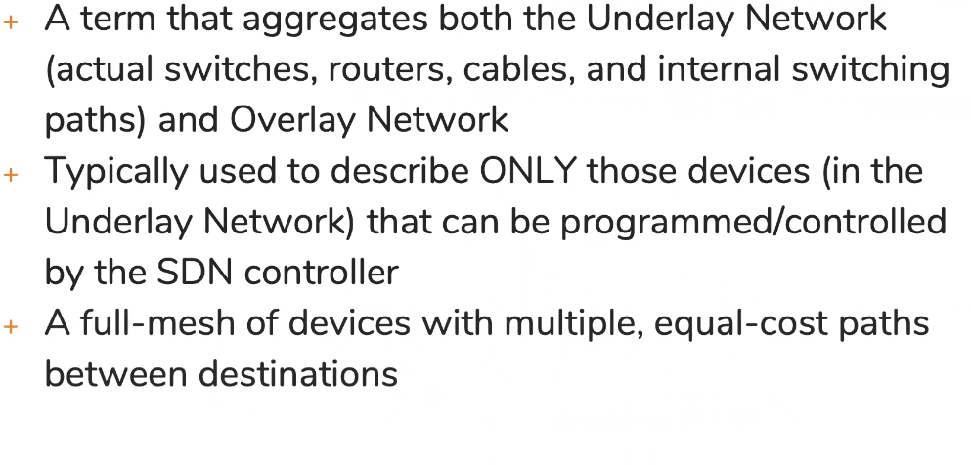
The Fabric

Slide 17
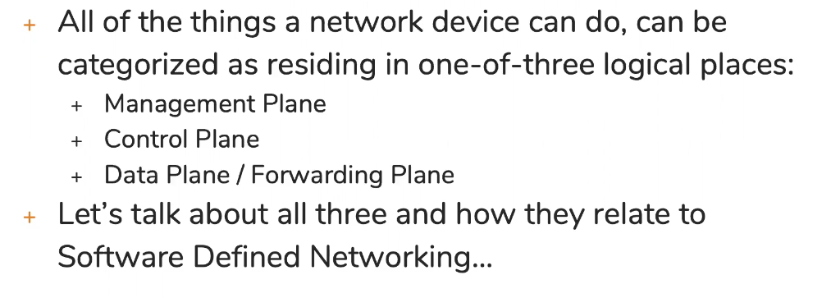
SDN relationships to the management, control and data plane
What is management, control and data plane

Slide 18
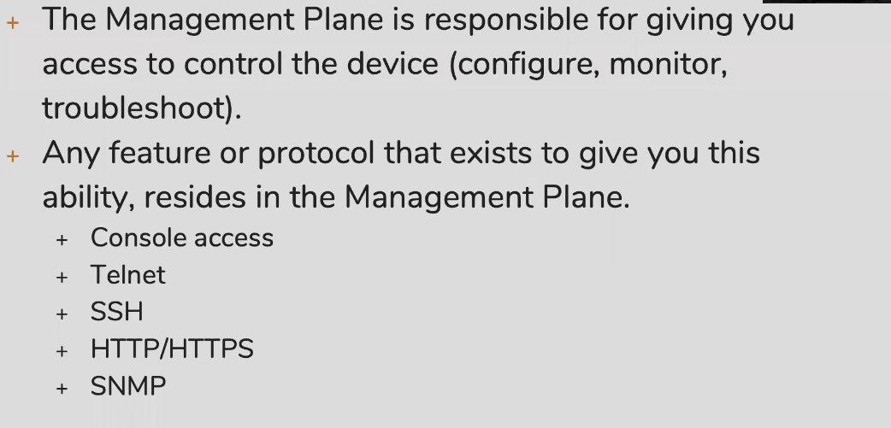
Management plane

Slide 19
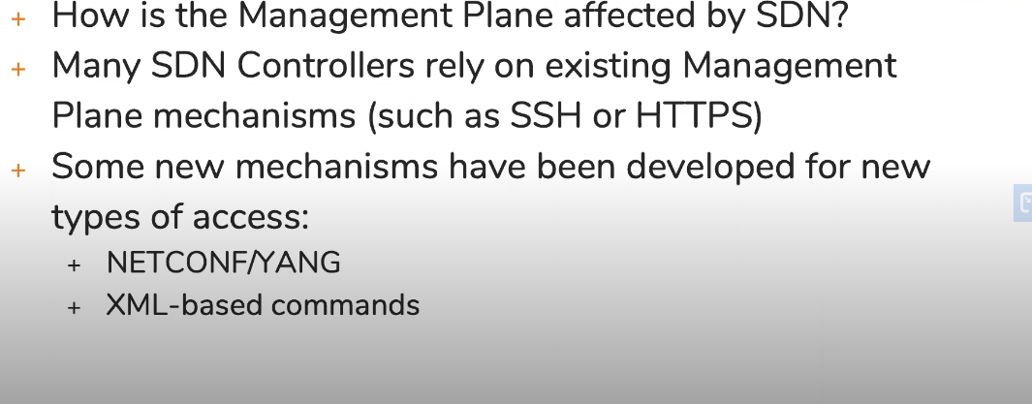
Management plane and SDN
Lets take example of configuring the root bridge on the cisco switch so what controller can do it will build the ssh session to the switch and implement the command.
Now lets say we want to do it on juniper switch and the command line of the juniper is different. So we came up with the common language that all the devices can understand that is what netconf is all about.

Slide 20
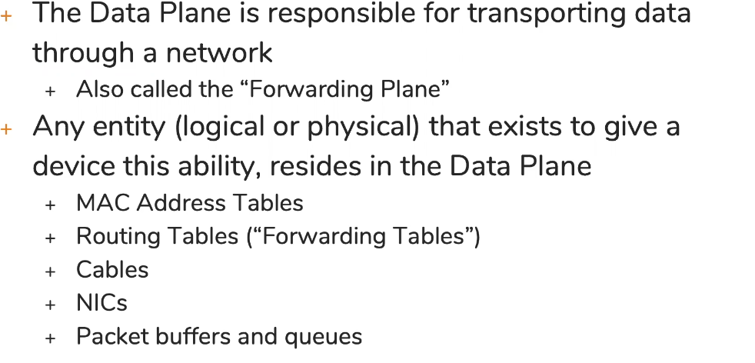
Data plane

Slide 21
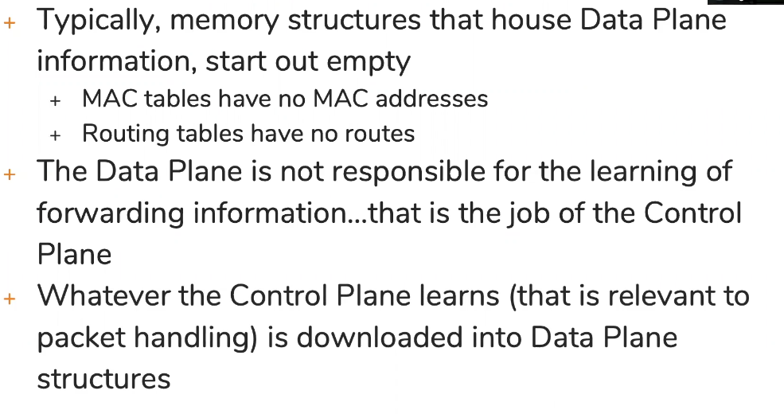
The population of the data plane

Slide 22
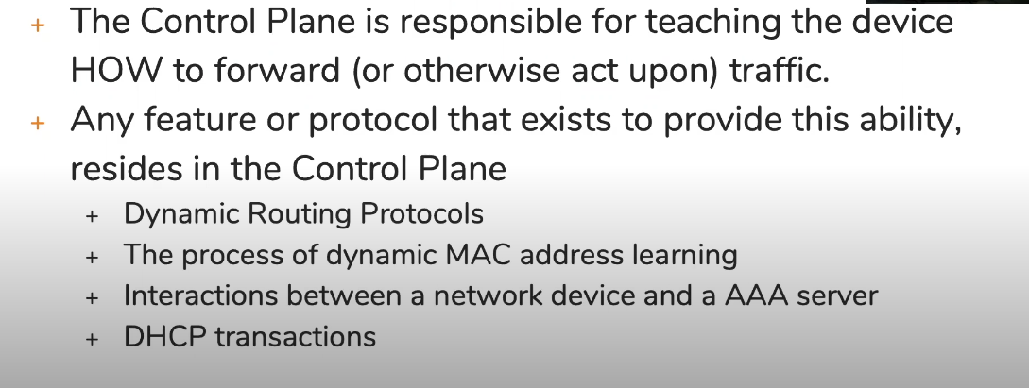
Control Plane

Slide 23
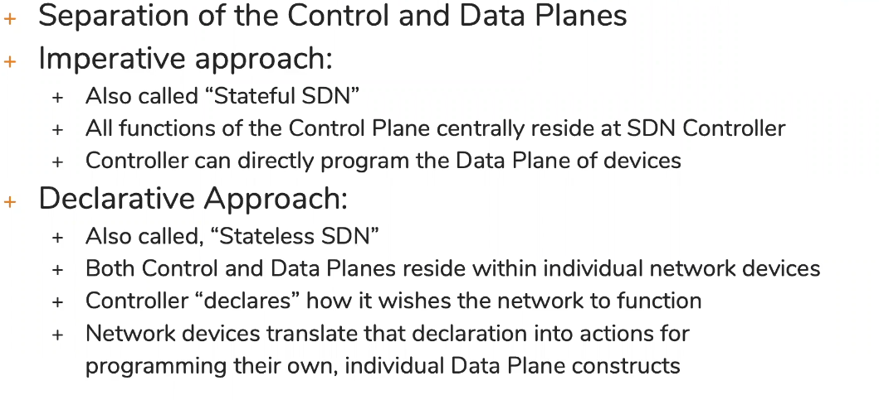
How SDN affects the control and data planes

Slide 25
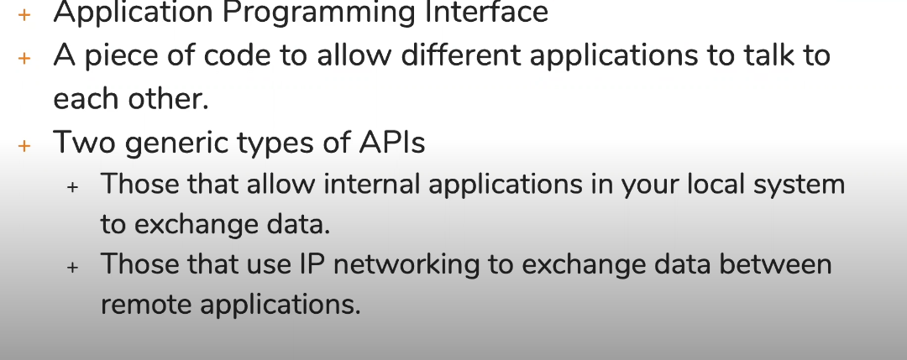
Introduction to Northbound and southbound APIs
What is an API

Slide 26
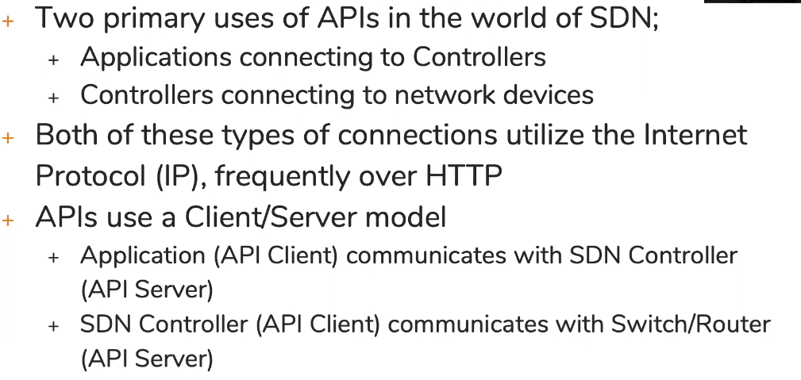
API usage in SDN

Slide 27
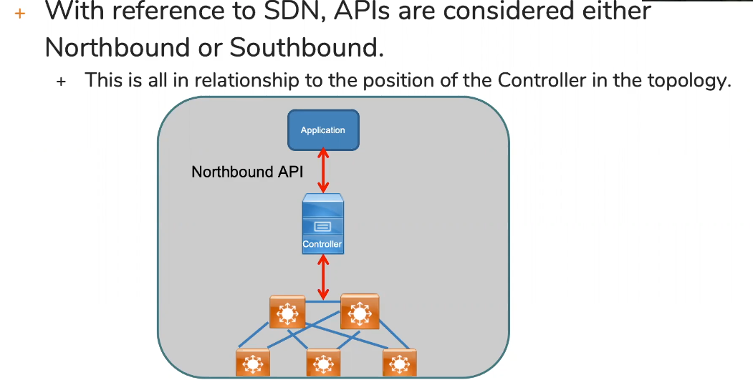
Northbound and Southbound API
If you want your application to talk to the controller then you should have some common northbound API supported on both controller and application
Same is the case with southbound API.
If your controller is using the netconf aa

Slide 28
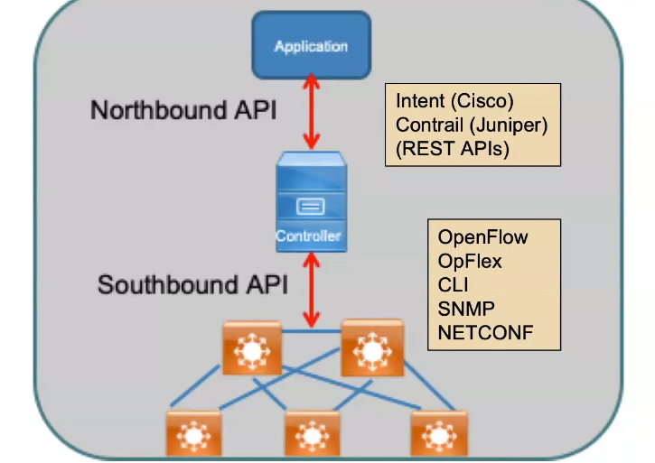
Example of Northbound and Southbound API
1. Intent (cisco) – if you want your application to talk to cisco controller like DNA then application should understand the Intent API
2. Contrail (juniper)
Both of the above are the example of RESTAPI

Slide 30
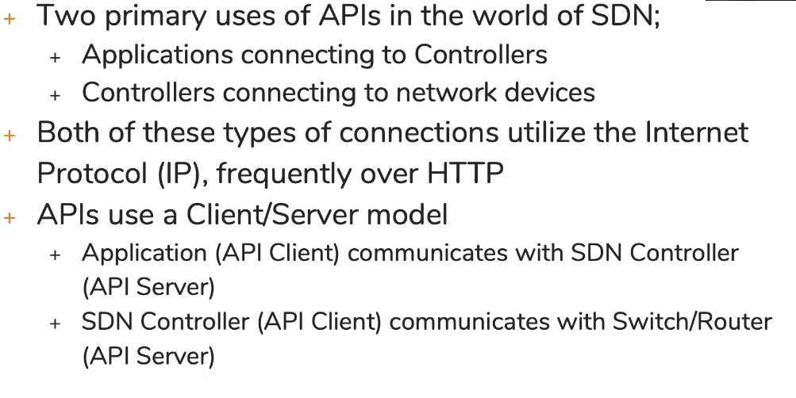
Characteristics of REST-based API

Slide 31
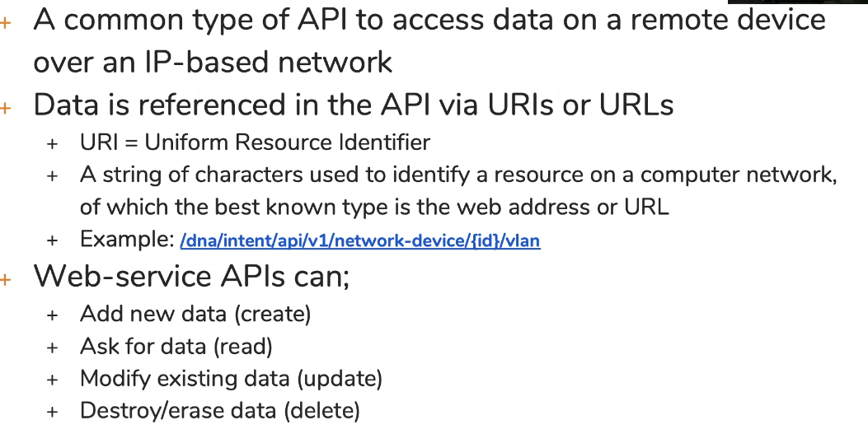
Web-service API
When you are using the REST Api the way the data is asked is in the form of URL or URI. It looks very similar to url in your browser.
In the REST api the url is reference to the object for eg. I want to read the routing table. I will send the URI to read the routing table.

Slide 32
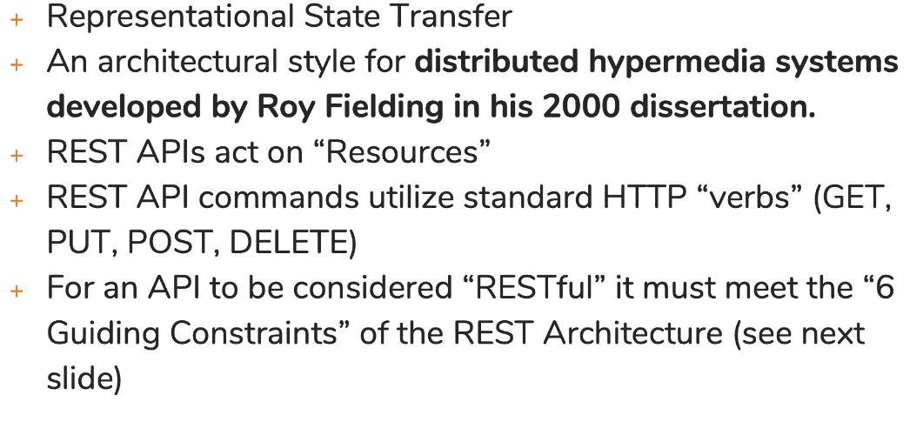
REST
If I am using the REST API to create something, I am creating a resource

Slide 33
One of the constraints of the REST is stateless
For an API to be REST it must meet 6 guiding constraints:
1. It should be stateless: it means it should not keep the track of what it did on the device. Whatever operation it is performing should be independent on the pervious operation because it doesn’t remember the previous operation.

Slide 34
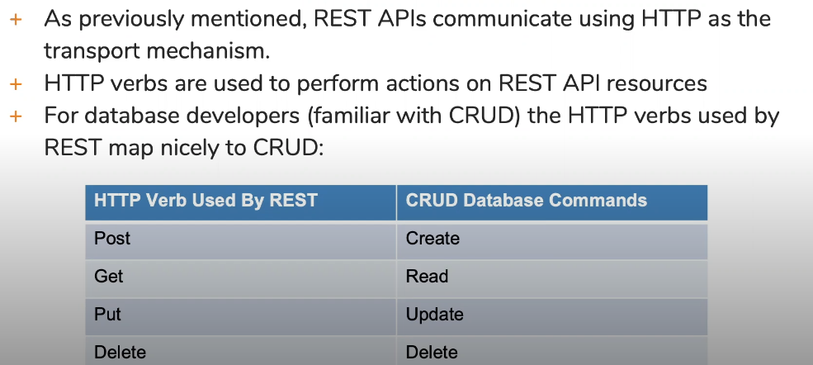
HTTP verbs & CRUD

Slide 35
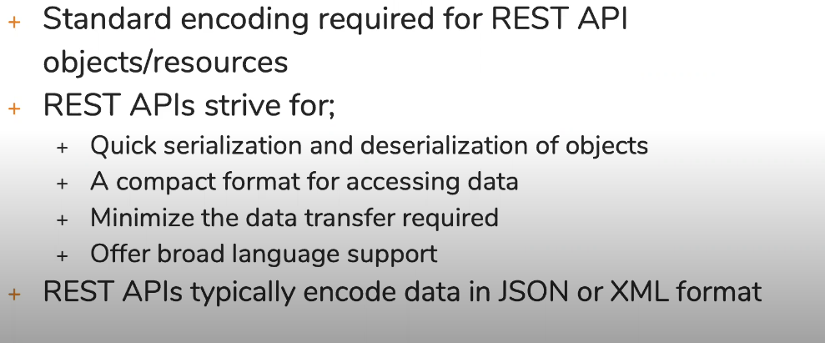
REST API Data Encoding

Slide 37
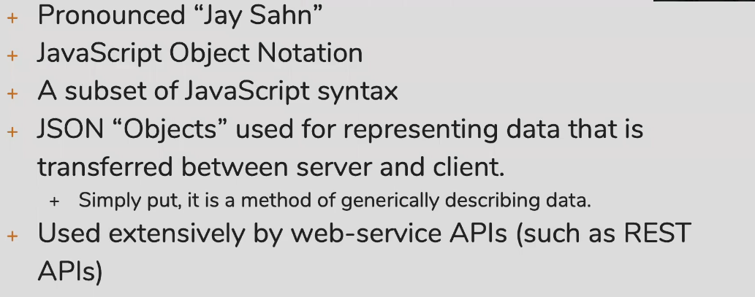
Encoding data with Jason

Slide 38
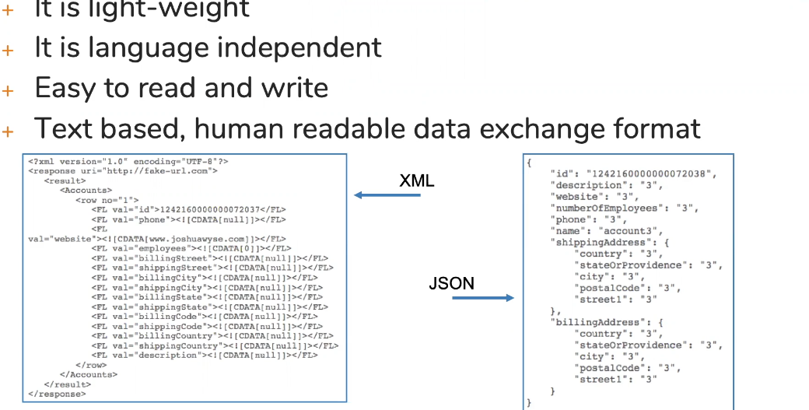

Slide 39
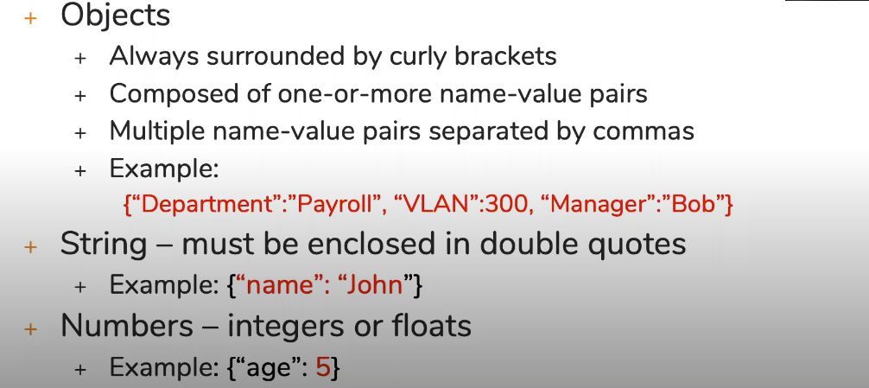
Example of Jason value types
Jason can use different types of data.

Slide 40
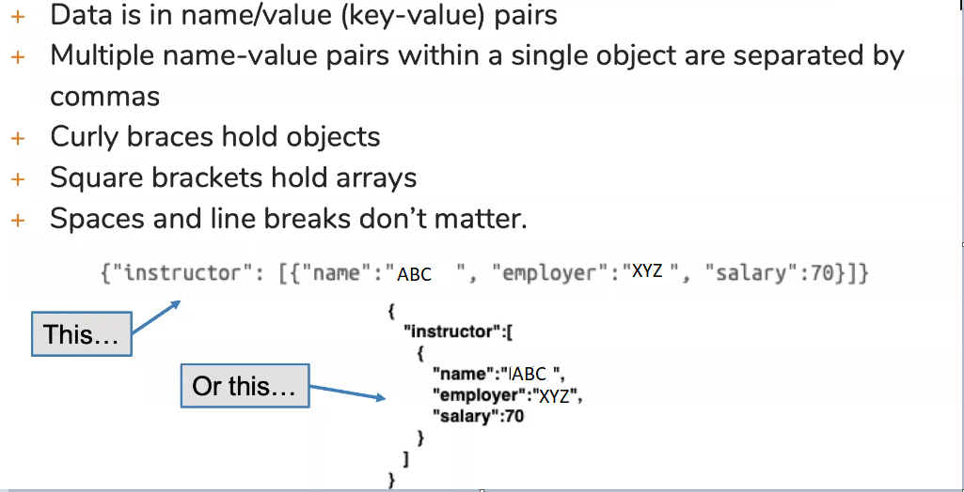
Jason Syntax rules

Slide 42
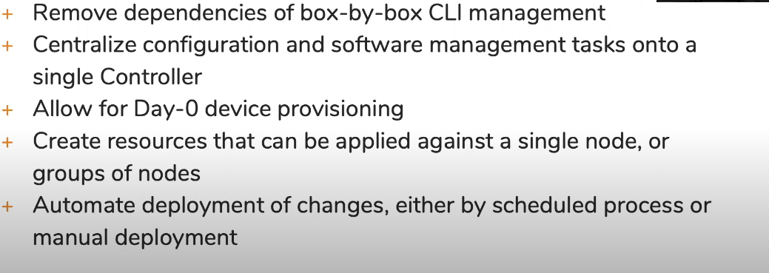
Overview of Network Automation Tools
Capabilities of configuration management tools:

Slide 43
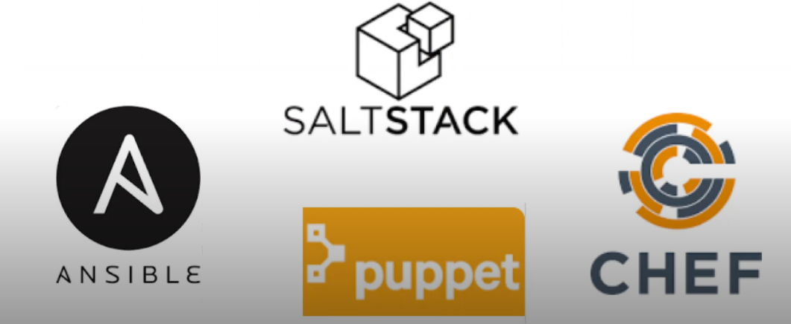
Common configuration Management Tools
This is just the high level overview. The purpose of this is that you should recognize the name of the automation tools.

Slide 44
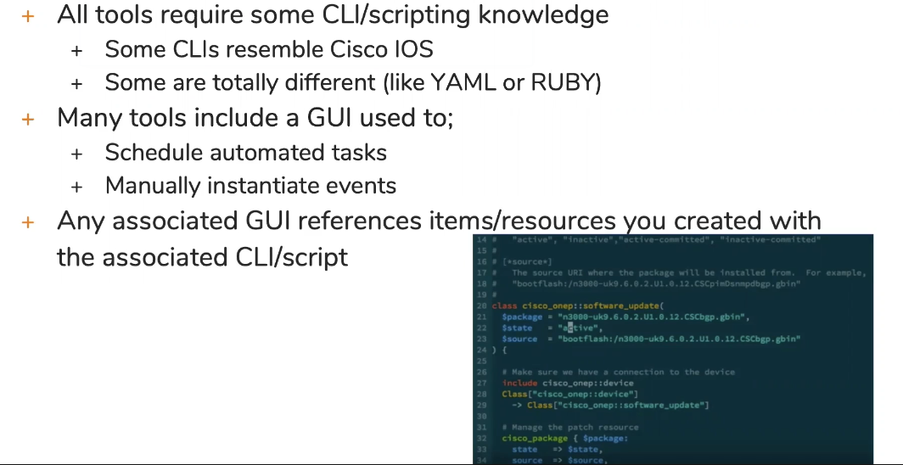
Config Management tools similarities

Slide 45
Difference between the tools
Some automation tools you will download the tools, configure the script using any language, provided the ip address of router or switch and login credentials. That tools will go the router/switch and do the changes or gather the information based on the script. That is the kind of standalone tools.
The other type of tools that we see here require 2 components:
Master – installed in your server
Agent -- code installed in your client
All these automation tools were not originally developed to automate the router and the switches. They were originally developed to work with servers.
Some devices may not allow you to install the agent. So they are not the candidate for the automation.

Slide 46
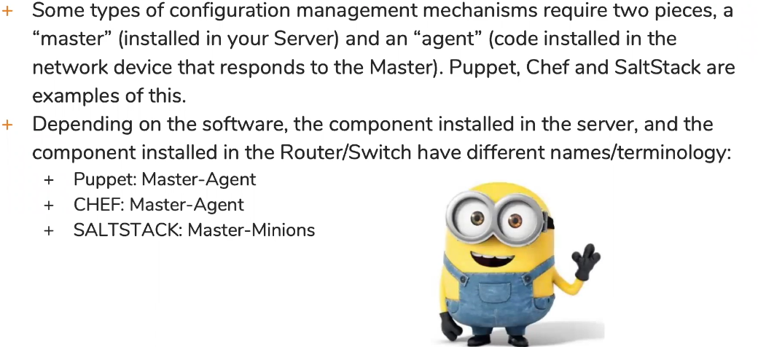
Master and Agent

Slide 47
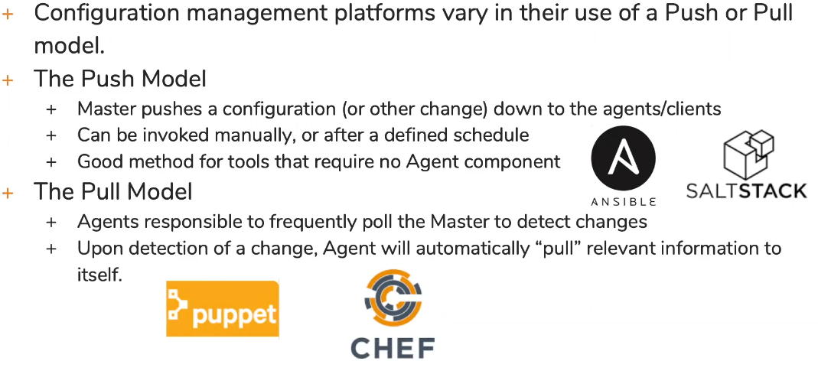
Push and Pull

Slide 48
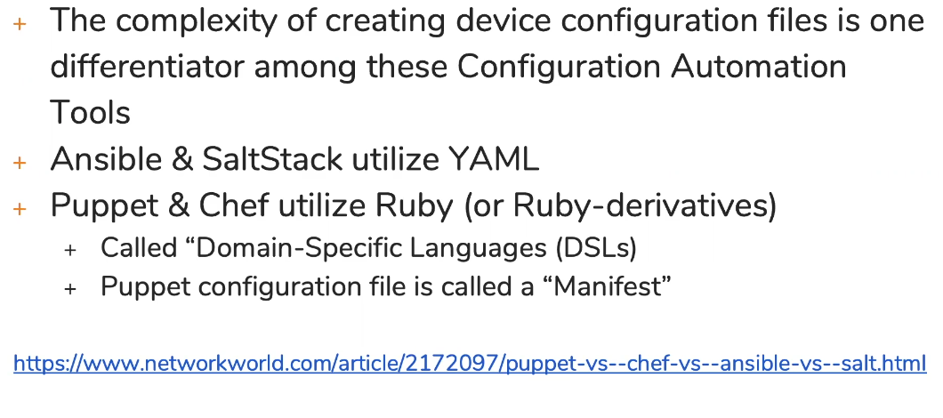
Creating Configuration File

Slide 49
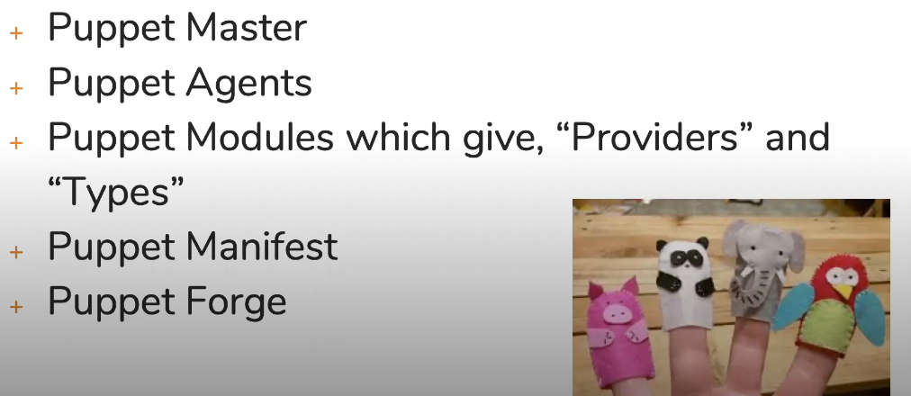
Puppet terminology & Concepts
Puppet manifest – configuration file
Puppet forge – this is basically the Website where you will get the sample manifest

Slide 50
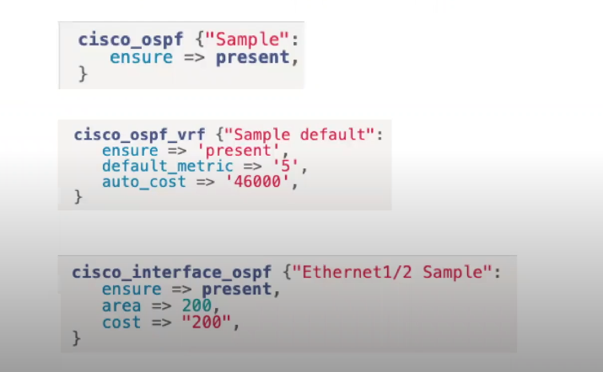
Example of puppet manifest

Slide 51
Chef terminology and concepts
Core Components:
1. Chef servers
2. Workstations: it will your laptop where you will building your configuration files.
3. Nodes: It is the server talking to the workstation
Changes are pushed from workstation to the server and then from server to node
4. Chef Cookbooks: it is the data construct that allow chef to know how it is going to talk to device. For eg. If I chef want to talk to cisco or juniper device the cookbook will tell how to talk.
5. Recipe: this is where the actual configuration reference are. It will tell chef how to do the configuration

Slide 52
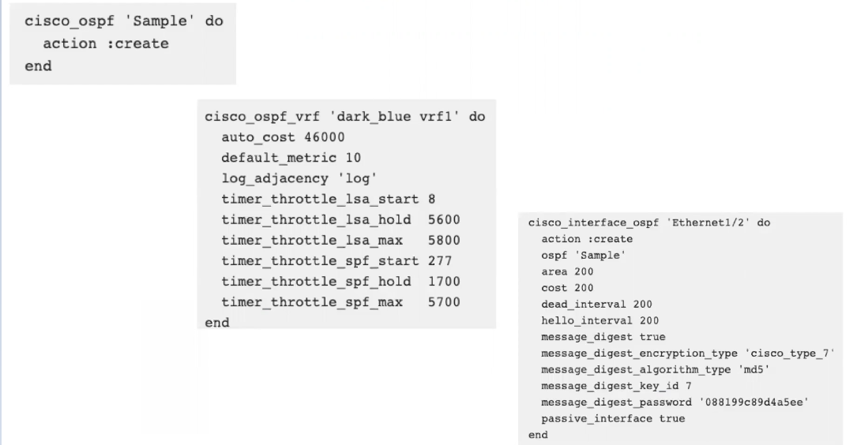
Examples of Chef recipes

Slide 53
Ansible terminology and concepts
Ansible Master – does not require agent component
Utilize the ssh to connect to the devices
Ansible playbooks – similar to the chef cookbooks
Ansible Modules – that’s where you will find the IOS commands

Slide 54
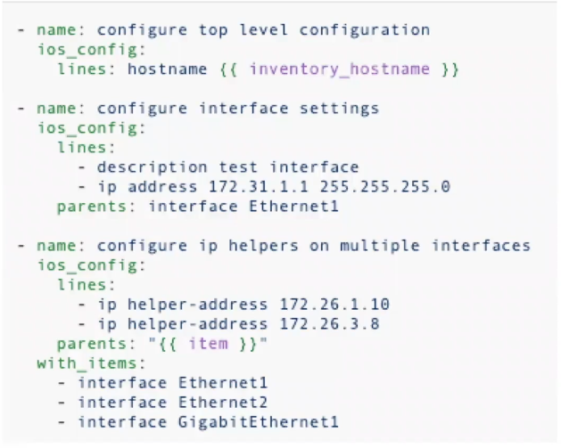
Ansible Module Example

